Slide 1
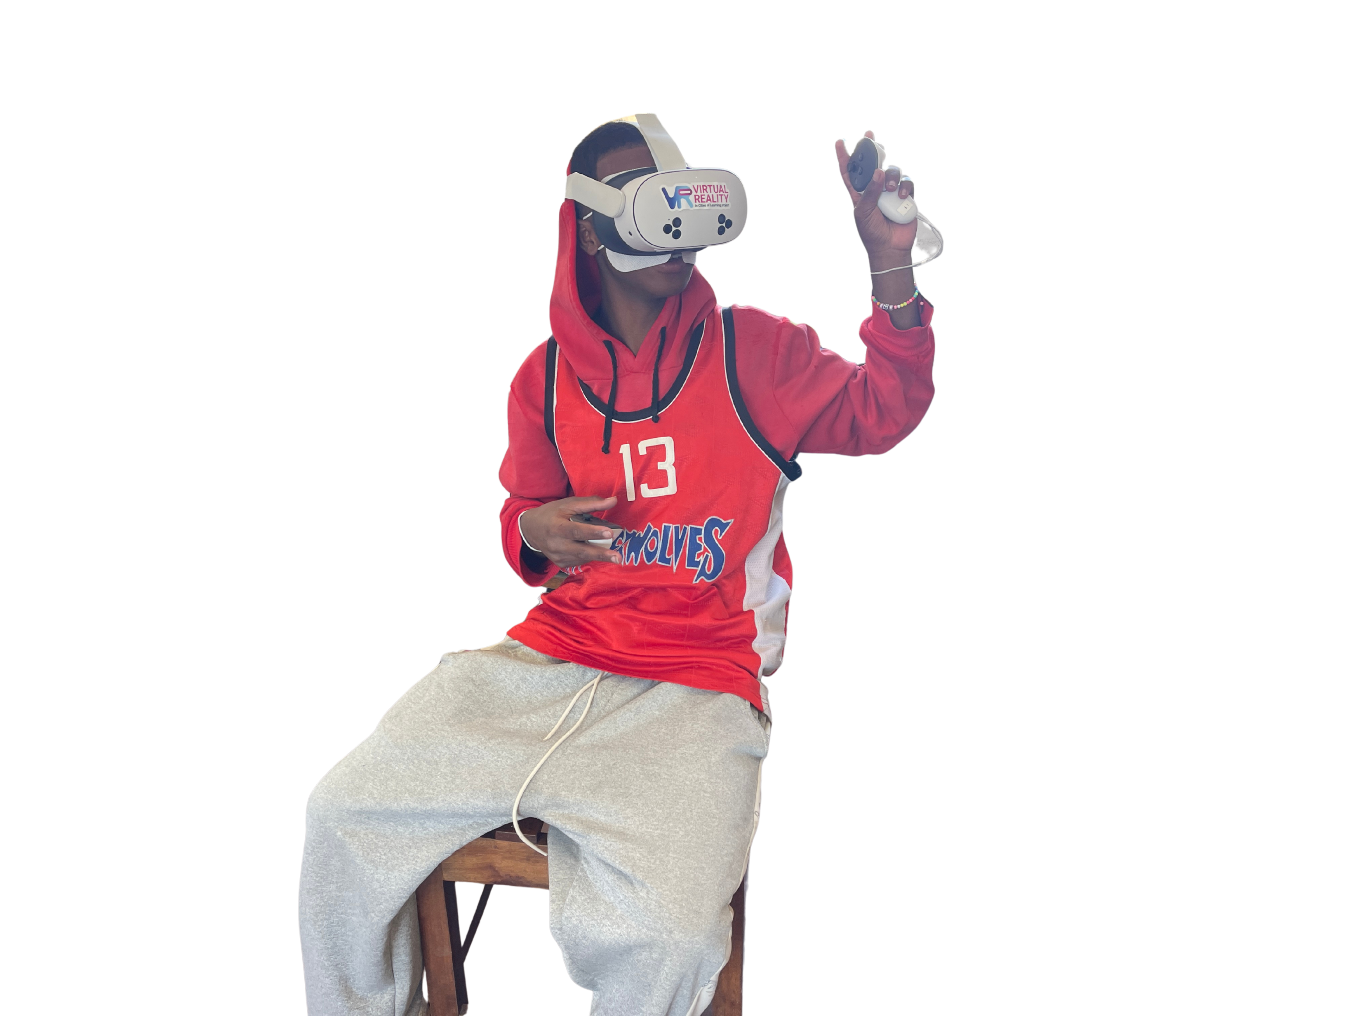

Need help while driving? Check here for the quickest controls!
  Right trigger: Accelerate / Drive forward
  Left trigger: Reverse / Drive backward
  B button: Instantly restart and return to the starting point if you fly off the track
  Joysticks in mid-air: Perform stunts (flips and spins) and land your car cleanly on all four wheels
  Collectibles: Collect required items along the track before you can cross the finish line
Get cracking!

Slide 2

Need help with building? Check here for the controls!
  Left wrist: Open the menu for track segment options, the paint tool, extra components, or to delete items.
  Trigger (Index finger): Select and place a track piece.
  Two hands + Grip: Grab the starting piece or objects with both hands to scale them up or down simultaneously.
  Grip (Side button): Grab an existing track piece to move or lift it.
Get building!

